Slide 1
Introduction of Computer
Networks
Lecture (1-2)
Computer Networks
Department of Computer Science and Engineering,
Chitkara University, Punjab

Slide 2
Index
Network affects our lives
Network Components
Types of Computer Networks
Network Topologies
Collision Domain
Broadcast Domain
Recent Network Trends and Network security

Slide 3
1. Networks affect our Lives
1 Networks Connect Us
In today’s world, through the use of networks, we are connected like never before. People with ideas can communicate instantly with others to make those ideas a reality. News events and discoveries are known worldwide in seconds. Individuals can even connect and play games with friends separated by oceans and continents
No Boundaries
The creation of online communities for the exchange of ideas and information has the potential to increase productivity opportunities across the globe. The creation of the cloud lets us store documents and pictures and access them anywhere, anytime. So whether we are on a train, in a park, or standing on top of a mountain, we can seamlessly access our data and applications on any device.

Slide 4
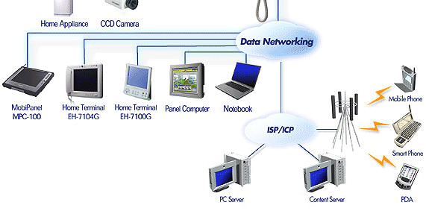
2. Network Components
End Devices : PC, Laptop, Mobile
Connecting Devices: Hubs, Switches, Routers
Transmission Media: Wired, Wireless Media
Software: Operating Systems for PCs and Connecting Devices
Figure 1 Shows the network components in detail.

Slide 5
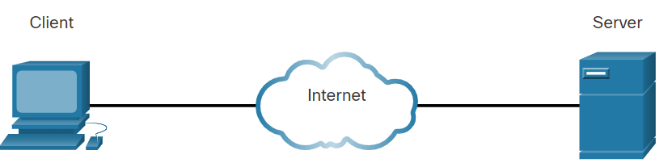
Network Components
1 Host
To be a part of a global online community, your computer, tablet, or smartphone must first be connected to a network. That network must be connected to the internet. This topic discusses the parts of a network.
Host: All computers that are connected to a network and participate directly in network communication are classified as hosts. Hosts can be called end devices. Some hosts are also called clients. However, the term hosts specifically refers to devices on the network that are assigned a number for communication purposes. This number identifies the host within a particular network.
IP: This number is called the Internet Protocol (IP) address. An IP address identifies the host and the network to which the host is attached.
Server: Servers are computers with software that allow them to provide information, like email or web pages, to other end devices on the network. Each service requires separate server software. For example, a server requires web server software to provide web services to the network. A computer with server software can provide services simultaneously to many different clients.
As mentioned, clients are a type of host. Clients have software for requesting and displaying the information obtained from the server, as shown in the figure.
Figure 2 Illustrates the Client as host and communicating with the Server.

Slide 6
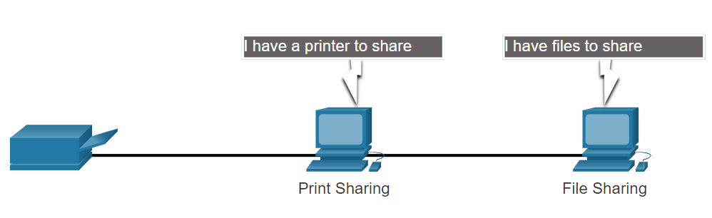
Network Components
2 Peer-to-Peer
Client and server software usually run on separate computers, but it is also possible for one computer to be used for both roles at the same time. In small businesses and homes, many computers function as the servers and clients on the network. This type of network is called a peer-to-peer network.
In the figure, the print-sharing PC has a Universal Serial Bus (USB) connection to the printer and a network connection, using a network interface card (NIC), to the file-sharing PC.
Figure 3 Shows the peer-to-peer communication.
Table 1 Shows the advantages and disadvantages of a Peer-to-Peer setup.
Advantages | Disadvantages
Easy to set up | No centralized administration
Less complex | Not a secure
Lower cost as network devices and dedicated servers are not essential | Not scalable
Used for a simple task like transfer files and sharing printers | All devices may act as both clients and servers which can slow their performance.

Slide 7
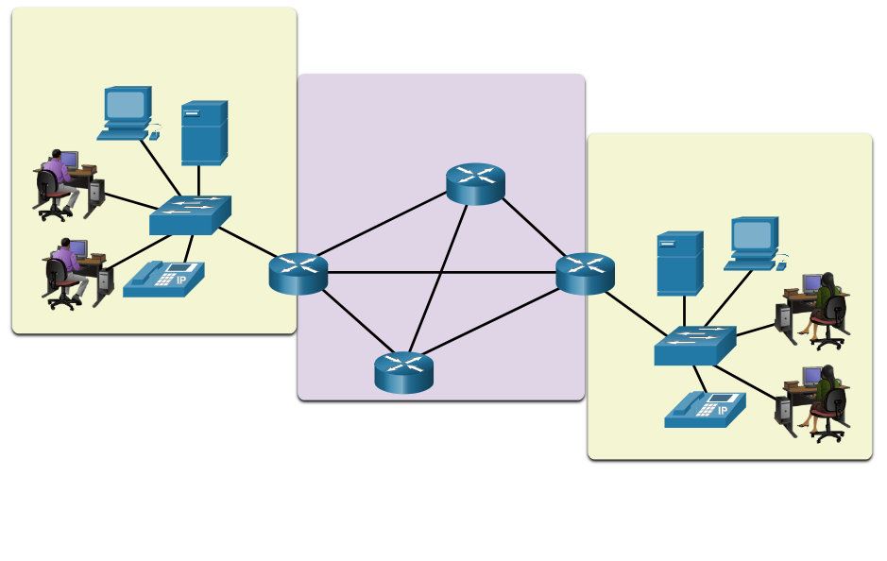
Network Components
3 End devices
The network devices that people are most familiar with are end devices. To distinguish one end device from another, each end device on a network has an address. When an end device initiates communication, it uses the address of the destination end device to specify where to deliver the message. An end device is either the source or destination of a message transmitted over the network.
Figure 4 shows end devices communication
Data originates from the end device, flows through the network, and reaches an end device.
End device
End device
LAN
Internetwork
LAN

Slide 8
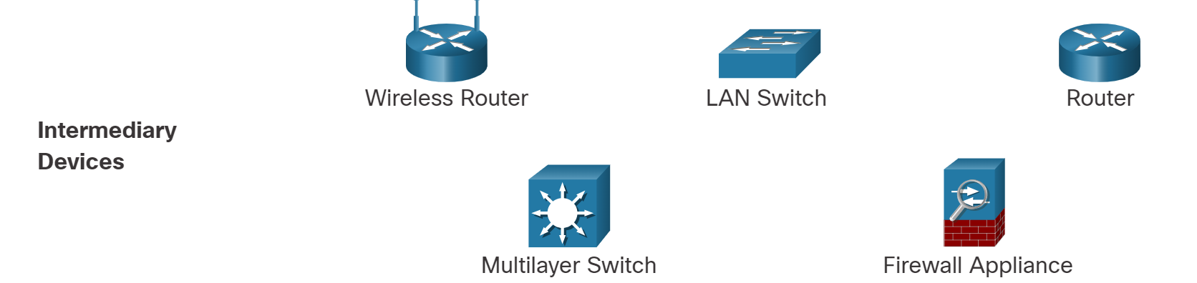
Network Components
4 Intermediary devices
Intermediary devices connect the individual end devices to the network. They can connect multiple individual networks to form an internetwork. These intermediary devices provide connectivity and ensure that data flows across the network. Intermediary devices use the destination end device address, in conjunction with information about the network interconnections, to determine the path that messages should take through the network. Examples of the more common intermediary devices and a list of functions are shown in the figure.
Functions: Regenerates and retransmits communication signals, Maintain information about what pathways exist through the network and internetwork, Notify other devices of errors and communication failures, Direct data along alternate pathways when there is a link failure, Classify and direct messages according to priorities, Permit or deny the flow of data, based on security settings
Figure 5 Shows the Intermediary devices used in the network.

Slide 9
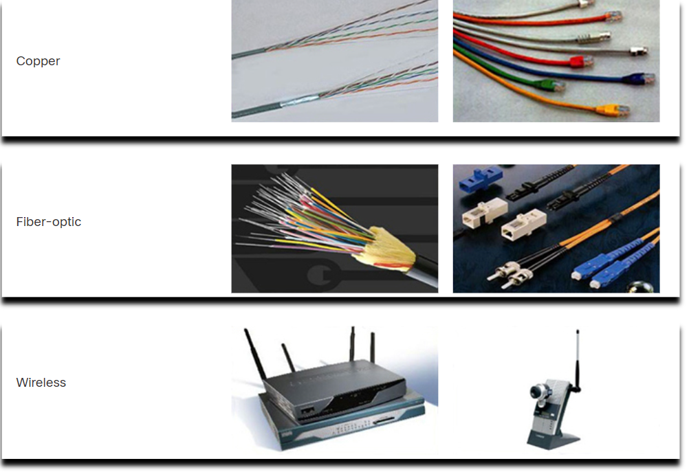
Network Components
5 Network Media
Communication transmits across a network of media. The media provides the channel over which the message travels from source to destination. Modern networks primarily use three types of media to interconnect devices, as shown in the figure:
Metal wires within cables - Data is encoded into electrical impulses.
Glass or plastic fibers within cables (fiber-optic cable) - Data is encoded into pulses of light.
Wireless transmission - Data is encoded via modulation of specific frequencies of electromagnetic waves.
Figure 6 Various ways of communication transmit across a network of media.
Criteria for choosing: max. distance, environment, amount of data, cost of media, and installation.

Slide 10
Network representation
In addition to these network components, specialized terminology is used to describe how each of these devices and media connect:
Network Interface Card (NIC) - A NIC physically connects the end device to the network.
Physical Port - A connector or outlet on a networking device where the media connects to an end device or another networking device.
Interface - Specialized ports on a networking device that connect to individual networks. Because routers connect networks, the ports on a router are referred to as network interfaces.
Note: The terms port and interface are often used interchangeably.

Slide 11
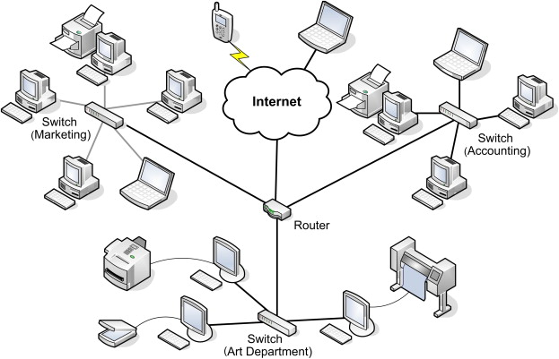
Different Types of Computer Networks
The classification of networks in computers can
be done according to their
i)Size: expressed by the
geographic area and number of computers
ii)Purpose: devices housed in a single room to
millions of devices spread across the world.
Figure 7 Generic computer network connections

Slide 12
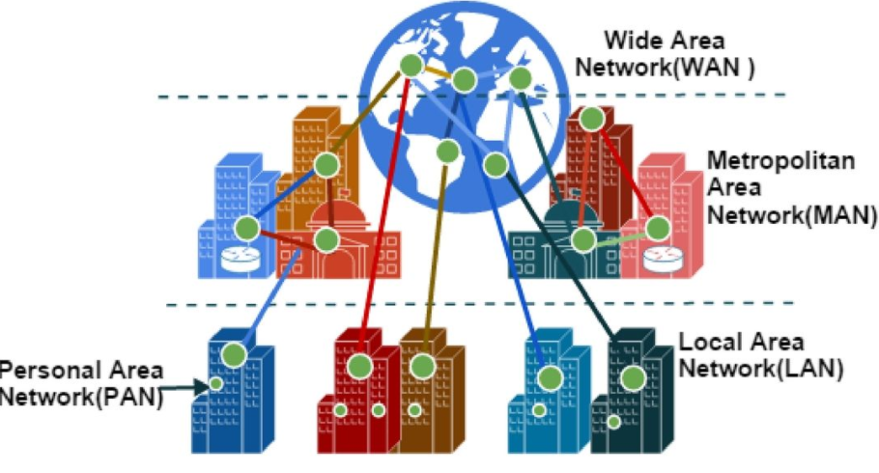
Types of Computer Networks
Figure 8 Types of computer networks

Slide 13
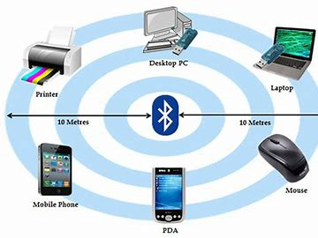
Personal Area Network
PAN (Personal Area Network) is a computer network formed around a person.
Characteristics of PAN
Below are the main characteristics of PAN:
It is mostly personal devices network equipped within a limited area.
Appliances use for PAN: cordless mice, keyboards, and Bluetooth systems.
Figure 9 Shows some of the PAN (Personal Area Network) appliances

Slide 14
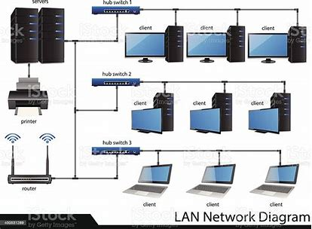
Local Area Network
A group of computer and peripheral devices which are connected in a limited area such as school, laboratory, home, and office building.
The simplest type of LAN network is to connect computers and a printer in someone’s home or office.
Figure 10 The simplest type of LAN network

Slide 15
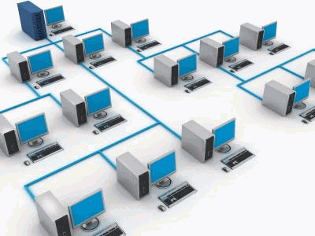
Local Area Network
Characteristics of LAN
Here are the important characteristics of a LAN network:
It is a private network, so an outside regulatory body never controls it.
LAN operates at a relatively higher speed compared to other WAN systems.
Figure 11 Generic workflow of the simplest type of LAN network

Slide 16
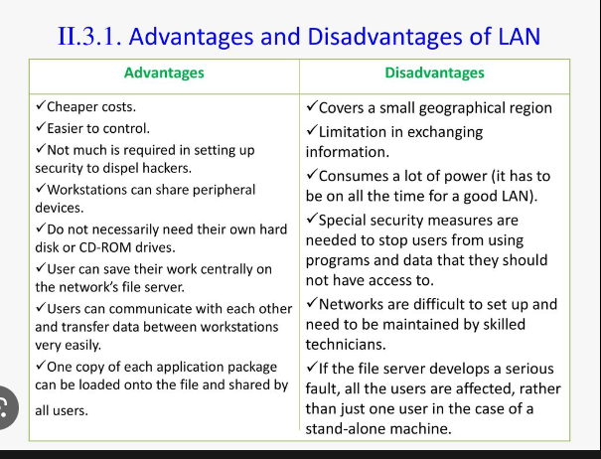
Advantages and Disadvantages of LAN

Slide 17
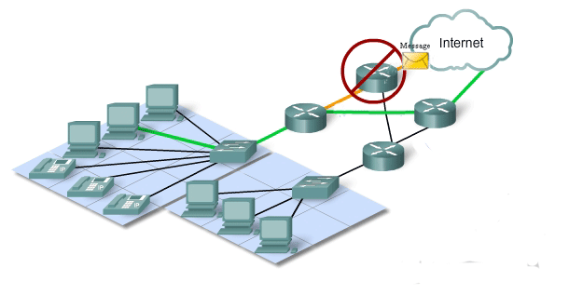
WAN:Wide Area Network
WAN is another important computer network that which is spread across a large geographical area.
Figure 12 The simplest type of WAN network

Slide 18
Intranets and Extranets
Two other terms are similar to the term internet: intranet and extranet.
Intranet: It is a term often used to refer to a private connection of LANs and WANs that belong to an organization. An intranet is designed to be accessible only by the organization's members, employees, or others with authorization.
Extranet: An organization may use an extranet to provide secure and safe access to individuals who work for a different organization but require access to the organization’s data. Here are some examples of extranets:
A company that is providing access to outside suppliers and contractors
A hospital that is providing a booking system to doctors so they can make appointments for their patients
A local office of education that provides budget and personnel information to the schools in its district

Slide 19
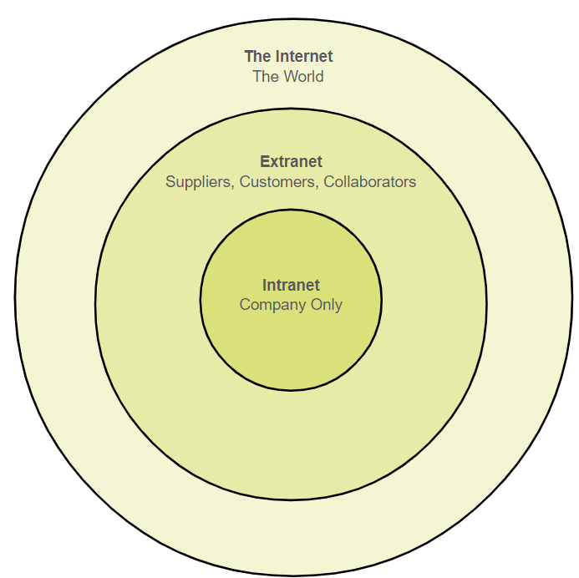
Intranets and Extranets
The figure illustrates the levels of access that different groups have to a company intranet, a company extranet, and the internet.
A center circle is labeled Intranet and has company-only access. Surrounding that is another circle labeled Extranet which is accessible by suppliers, customers, and collaborators. Surrounding that is another circle labeled the Internet which is accessible by the world.
Figure 13 illustrates the levels of access that different groups have to a company intranet, a company extranet, and the internet

Slide 20
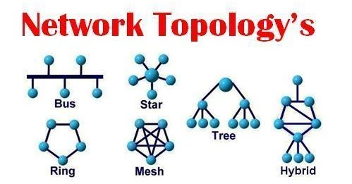
Topologies
The Physical or Logical layout of a network is known as Topology of the network.
It can be divided into:
i) Physical Topology
ii)Logical Topology
Figure 14 Various network Topology’s.

Slide 21
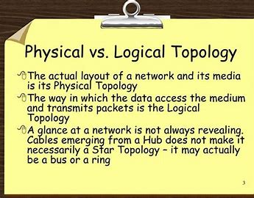
Topologies

Slide 22
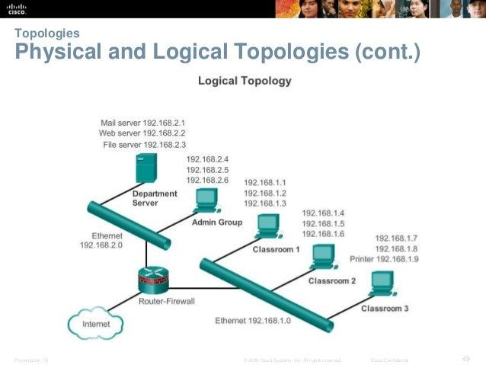
Topologies
This example shows the department server, one admin, various classroom that are connected to each other
by routers, ethernet, internet and various addresses. This depict the way data is accessed and transmit packets is example of logical topology.
Figure 15 Illustrates logical topology.

Slide 23
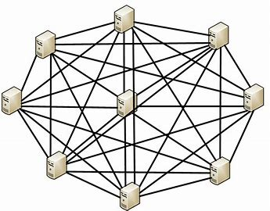
Mesh Topology
In a mesh topology, every device is connected to another device via a particular channel.
Every device is connected with another via dedicated channels. These channels are known as links.
Figure 16 Illustrates Mesh topology.

Slide 24
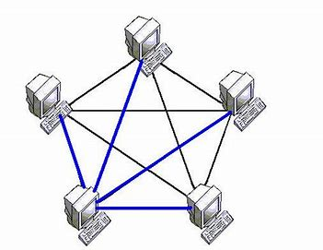
Mesh Topology
Suppose, N number of devices are connected with each other in a mesh topology, the total number of ports that are required by each device is N-1.
In Figure 17, there are 5 devices connected to each other, hence the total number of ports required by each device is 4. Total number of ports required=N*(N-1).
Suppose, N number of devices are connected with each other in a mesh topology, then the total number of dedicated links required to connect them is ^{N}C₂ i.e. N(N-1)/2. In Figure 1, there are 5 devices connected to each other, hence the total number of links required is 5*4/2 = 10.
Figure 17 Mesh topology with 5 computers connections.

Slide 25
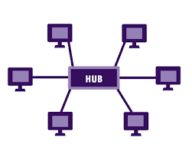
Star Topology
In star topology, all the devices are connected to a single networking device through a cable. This central device may be hub, switch, router and all other nodes are connected to the central node.
Figure 18 Star topology, Hub at centre and rest all are PC’s

Slide 26
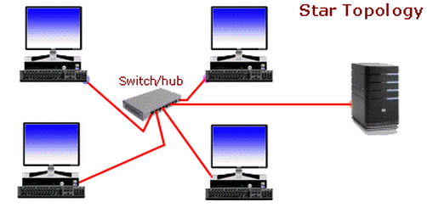
Star Topology
Advantages of this topology :
If N devices are connected in a star topology, then the number of cables required to connect them is N. So, it is easy to set up.
Each device requires only 1 port i.e. to connect to the hub, therefore the total number of ports required is N.
Problems with this topology :
If the concentrator (hub) on which the whole topology relies fails, the whole system will crash down.
The cost of installation is high.
Performance is based on the single concentrator i.e. hub.
Figure 19 Workflow of Star topology

Slide 27
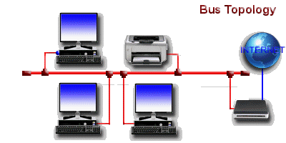
Bus Topology
Bus topology is a network type in which every computer and network device is connected to a single cable. It transmits the data from one end to another in a single direction. No bi-directional feature is in bus topology.
Figure 20 Workflow of Bus topology

Slide 28
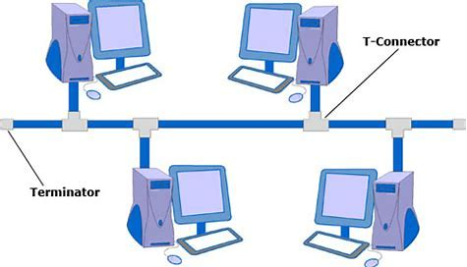
Bus Topology
Advantages of this topology :
If N devices are connected in a bus topology, then the number of cables required to connect them is 1, which is known as backbone cable, and N drop lines are required.
The cost of the cable is less as compared to other topologies, but it is used to build small networks.
Problems with this topology :
If the common cable fails, then the whole system will crash down.
If the network traffic is heavy, it increases collisions in the network. To avoid this, various protocols are used in the MAC layer known as Pure Aloha, Slotted Aloha, CSMA/CD, etc.
Security is very low.
Figure 21 Bus topology connection.

Slide 29
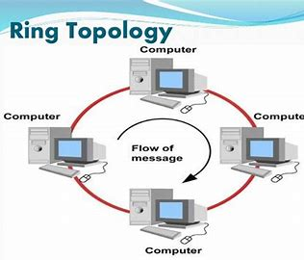
Ring Topology
In this topology, it forms a ring connecting devices with exactly two neighboring devices.
Several repeaters are used for Ring topology with a large number of nodes, because if someone wants to send some data to the last node in the ring topology with 100 nodes, then the data will have to pass through 99 nodes to reach the 100th node. Hence to prevent data loss repeaters are used in the network.
The transmission is unidirectional, but it can be made bidirectional by having 2 connections between each Network Node, it is called Dual Ring Topology.
Figure 22 Flow of message in Ring topology.

Slide 30
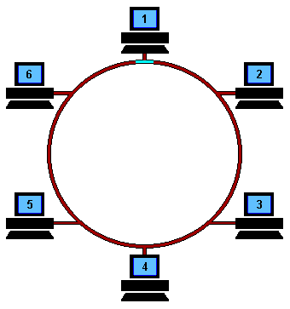
Ring Topology
The following operations take place in ring topology are :
One station is known as a monitor station which takes all the responsibility to perform the operations.
To transmit the data, the station has to hold the token. After the transmission is done, the token is to be released for other stations to use.
When no station is transmitting the data, then the token will circulate in the ring.
There are two types of token release techniques: Early token release releases the token just after transmitting the data and Delay token release releases the token after the acknowledgment is received from the receiver.
Figure 23 Operations in Ring topology.

Slide 31
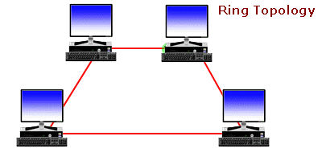
Ring Topology
Advantages of this topology :
The possibility of collision is minimum in this type of topology.
Cheap to install and expand.
Problems with this topology :
Troubleshooting is difficult in this topology.
The addition of stations in between or removal of stations can disturb the whole topology.
Less secure.
Figure 24 Operations in Ring topology.

Slide 32
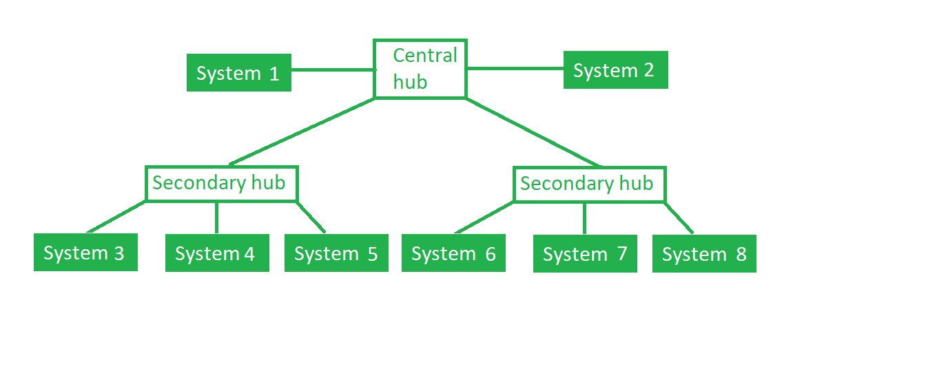
Tree Topology
This topology is the variation of Star topology. This topology has a hierarchical flow of data.
Figure 25 Shows Tree topology’s hierarchical flow of data.

Slide 33
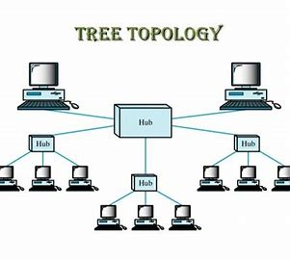
Tree Topology
In this, the various secondary hubs are connected to the central hub which contains the repeater. In this data flow from top to bottom i.e. from the central hub to secondary and then to the devices or from bottom to top i.e. devices to the secondary hub and then to the central hub.
Figure 26 Tree topology connected to the central and secondary hub.

Slide 34
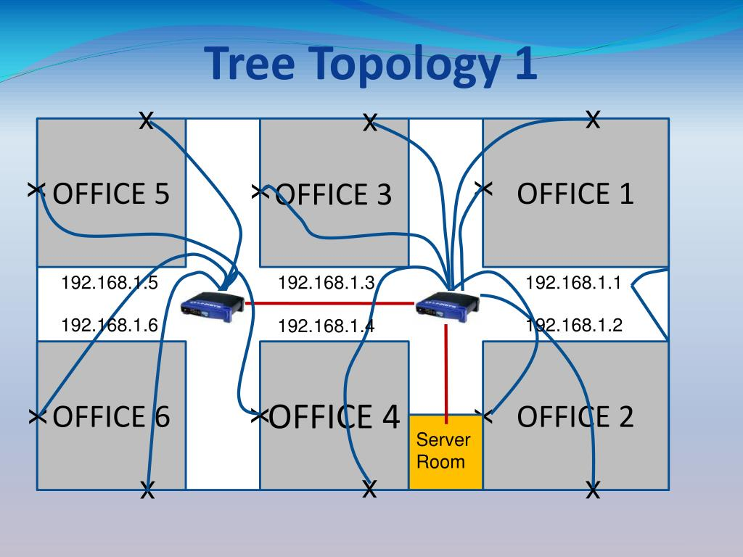
Tree Topology
Figure 27 Tree topology with specific addresses.

Slide 35
Tree Topology
Advantages of this topology :
It allows more devices to be attached to a single central hub thus it decreases the distance that is traveled by the signal to come to the devices.
It allows the network to get isolated and also prioritize from different computers.
Problems with this topology :
If the central hub gets fails the entire system fails.
The cost is high because of cabling.

Slide 36
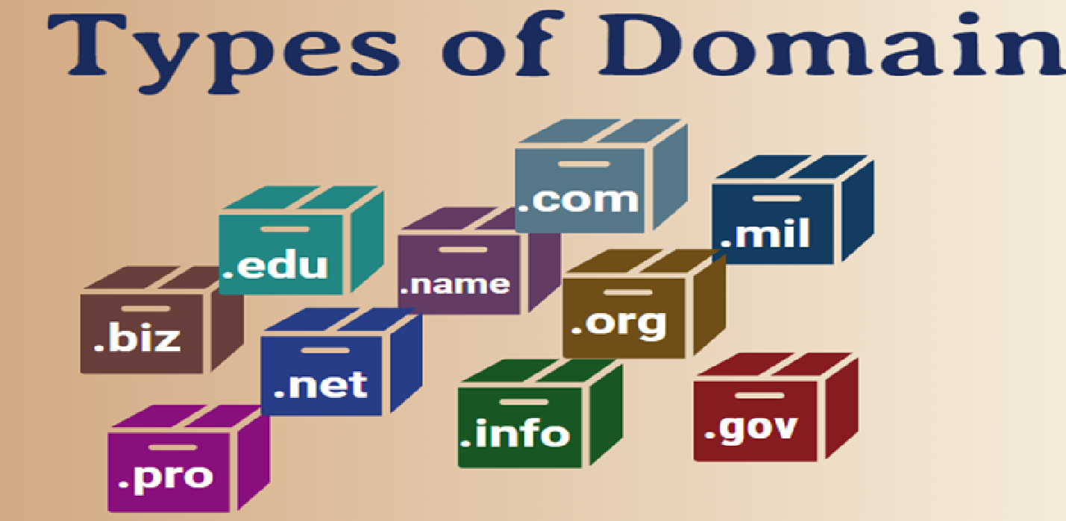
What is Domain?
A domain is a type of computer network in which all user computers, printer accounts, and other devices are registered.
It is a central database located on single or multiple clusters of central computers, that is known as domain controllers.
Figure 28 Shows types of Domain

Slide 37
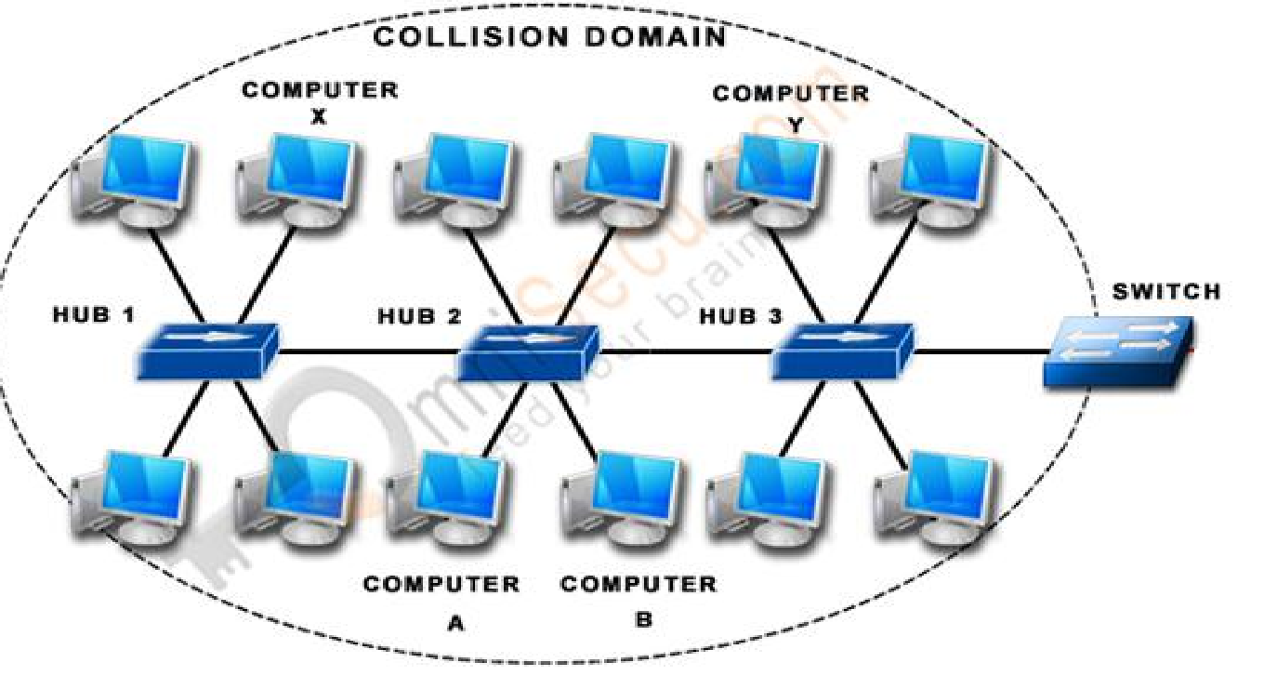
Collision Domain
Collisions will happen in an Ethernet Network when two devices simultaneously try to send data on the Shared Media, since Shared Media is half-duplex and sending and receiving are not supported at the same time.
Collisions are a normal part of life in an Ethernet network when Ethernet operates in a Half-duplex and under most circumstances should not be considered a problem.
A Collision Domain is any network segment in which collisions can happen (usually in Ethernet networks). In other words, a Collision Domain consists of all the devices connected using a Shared Media (Bus Topology or using Ethernet Hubs) where a Collision can happen between any device at any time.
Figure 29 Shows collision domain in detail with connection.

Slide 38
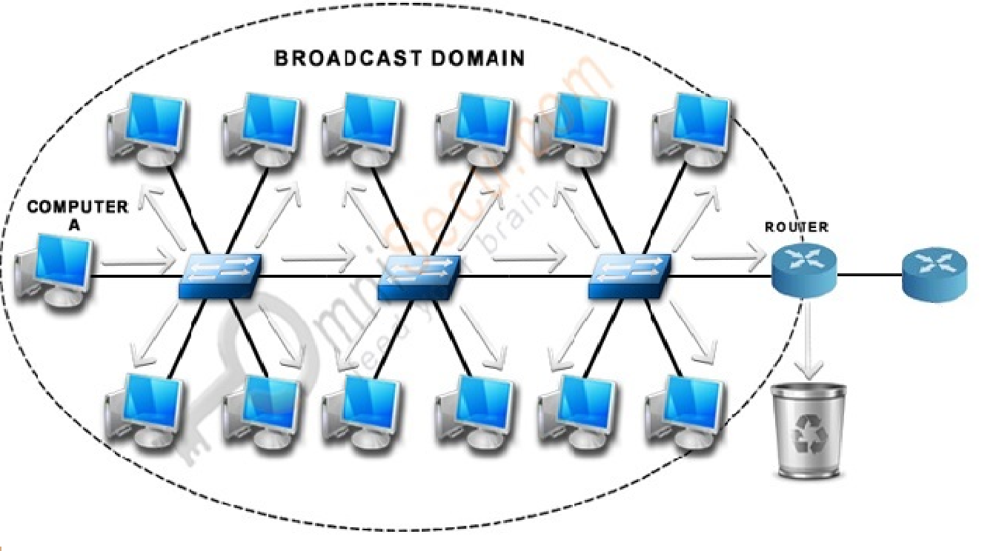
Broadcast Domain
Broadcast is a type of communication, where the sending device send a single copy of data and that copy of data will be delivered to every device in the network segment. Broadcast is a required type of communication and we cannot avoid Broadcasts, because many protocols (Example: ARP and DHCP) and applications are dependent on Broadcast to function.
A Broadcast Domain consists of all the devices that will receive any broadcast packet originating from any device within the network segment.
In Mention picture, "Computer A" is sending a broadcast and switch will forward it to every ports and all the switches will get a copy of broadcast packet. Every switch will flood the broadcast packet to all the ports. Router also will get a copy of broadcast packet, but the Router will not forward the packet to the next network segment.
As the number of devices in the Broadcast Domain increases, number of Broadcasts also increases and the quality of the network will come down.
Figure 30 Shows broadcast domain in detail with the connection.

Slide 39
Recent Network Trends
Several networking trends affect organizations and consumers:
Bring Your Own Device (BYOD): BYOD enables end users the freedom to use personal tools to access information and communicate across a business or campus network. These include laptops, notebooks, tablets, smartphones, and e-readers. These may be purchased by the company or school, purchased by the individual, or both.
Online collaboration: Collaboration is defined as “the act of working with another or others on a joint project.” Collaboration tools, like Cisco WebEx give employees, students, teachers, customers, and partners a way to instantly connect, interact, and achieve their objectives. Collaboration is also a priority in education. Students need to collaborate to assist each other in learning, to develop the team skills used in the workforce, and work together on team-based projects.
Video communications: Video conferencing is a powerful tool for communicating with others, both locally and globally. Video is becoming a critical requirement for effective collaboration as organizations extend across geographic and cultural boundaries.
Cloud Computing: Cloud computing is one of the ways that we access and store data. Cloud computing allows us to store personal files, even backup an entire drive on servers over the internet. Applications such as word processing and photo editing can be accessed using the cloud.
Network security: Network security is an integral part of computer networking. Some common security threats are Viruses, worms, Trojan horses, Spyware and adware, Zero-day attacks, Threat actor attacks, Denial of service attacks, Identity theft, etc. Further, security solutions can be Antivirus and antispyware, Firewall filtering, etc.

Slide 40
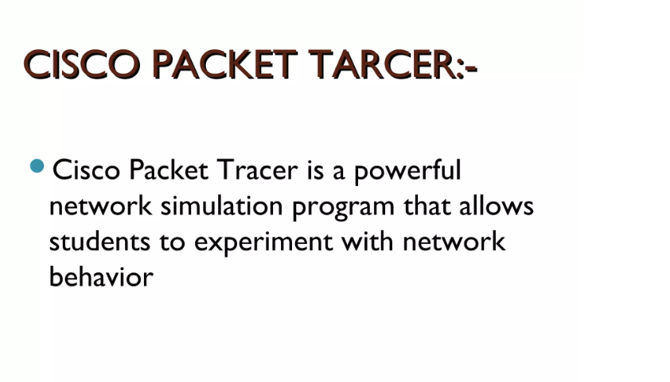
Cisco Packet Tracer

Slide 41
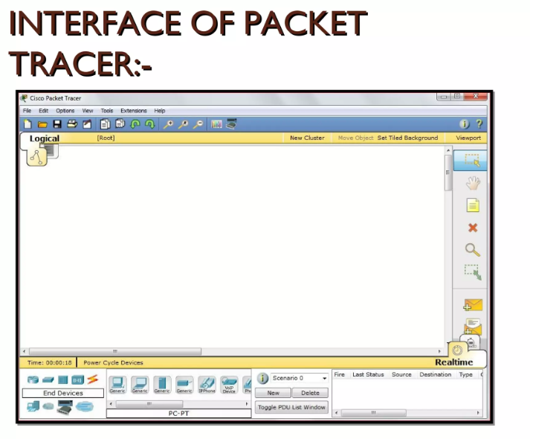
Cisco Packet Tracer

Slide 42
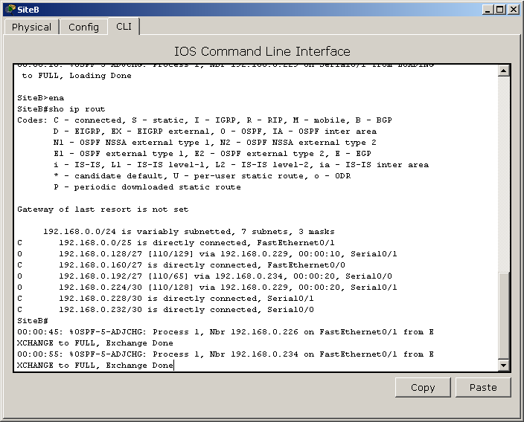
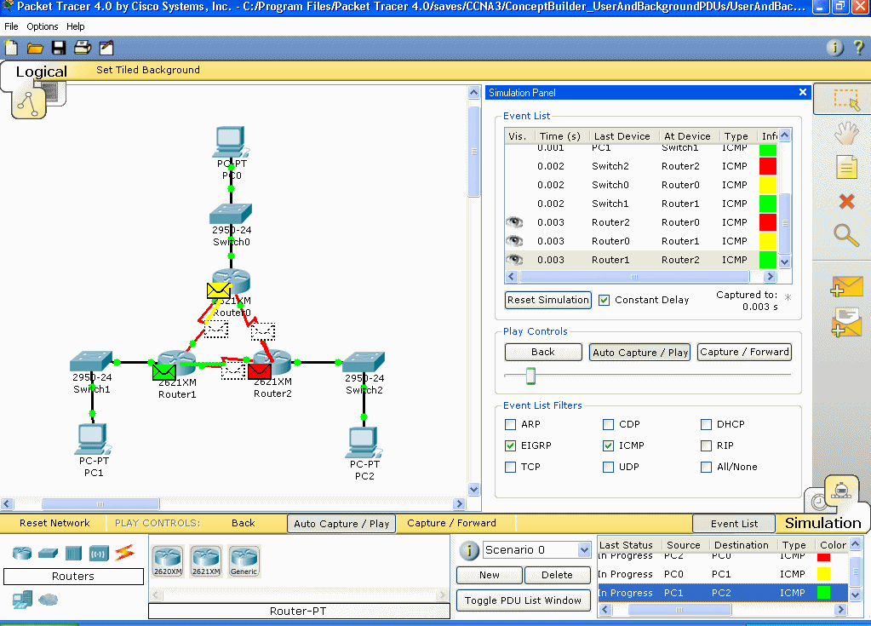
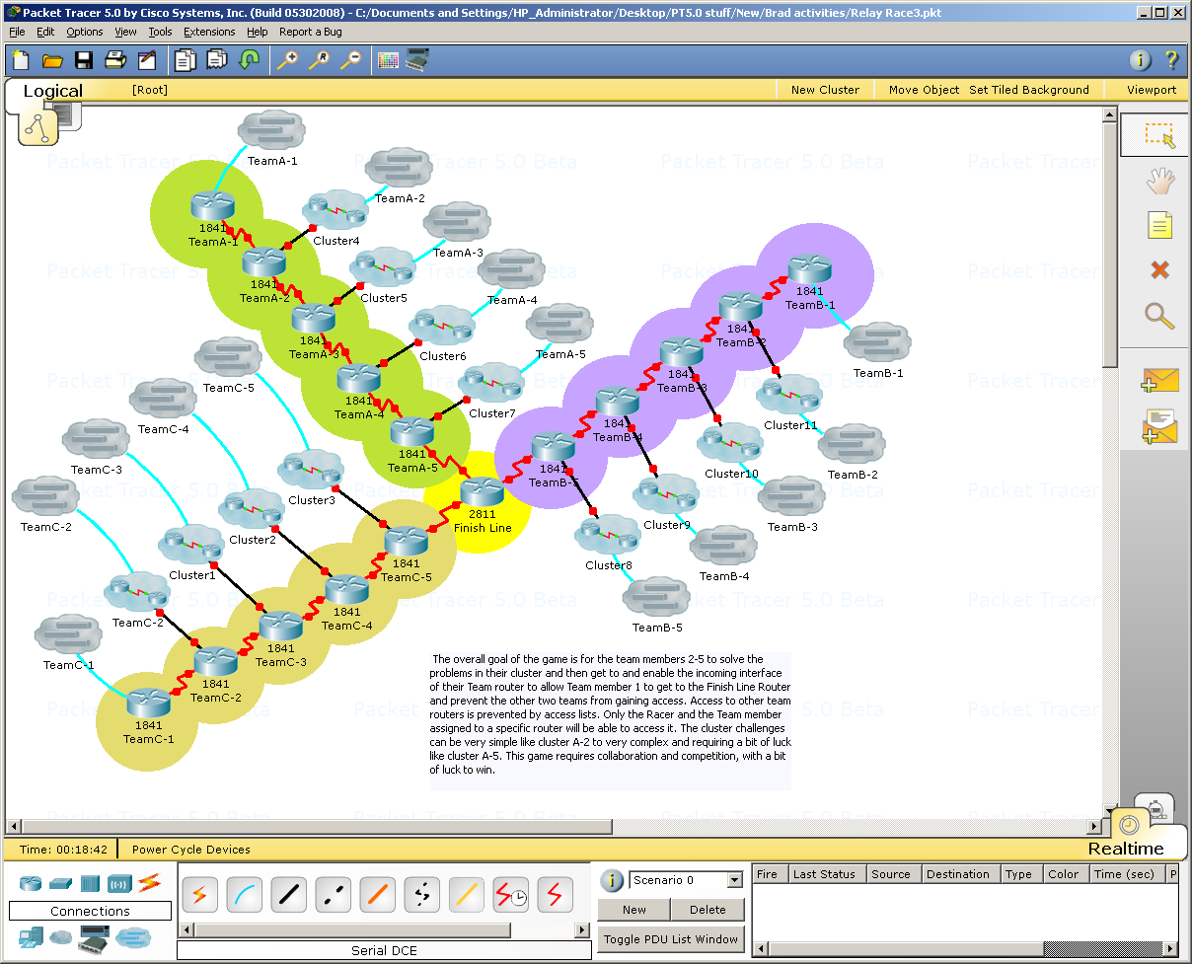
Simulation, Visualization, Collaboration
simulate IOS commands
visualize network traffic
collaborate on multiuser activities

Slide 43
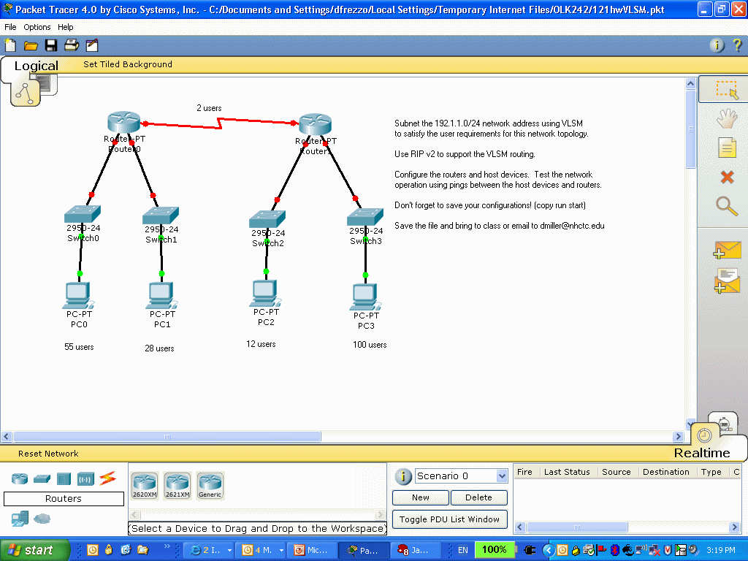
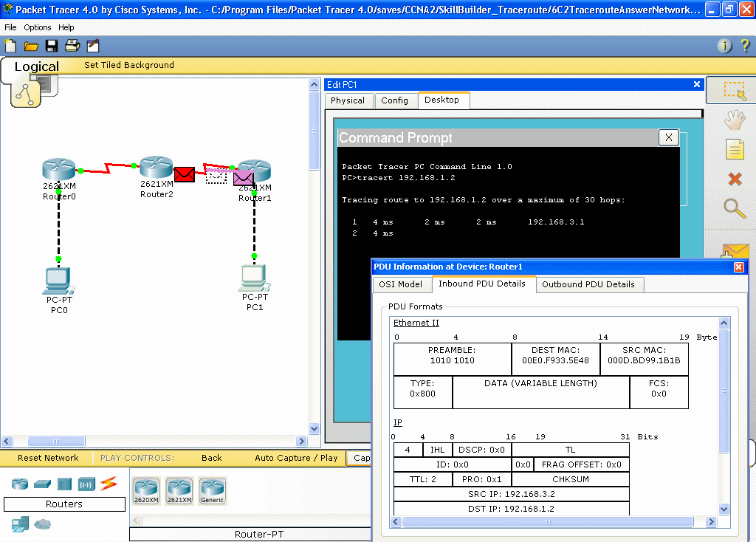
Supports Homework and Pre-Lab Prep

Slide 44
Questions
1.During a routine inspection, a technician discovered that software that was installed on a computer was secretly collecting data about websites that were visited by users of the computer. Which type of threat is affecting this computer?
identity theft
spyware
zero-day attack
DoS attack​
Which term refers to a network that provides secure access to the corporate offices by suppliers, customers and collaborators?
Internet
extranet
extendednet
Intranet
A large corporation has modified its network to allow users to access network resources from their personal laptops and smart phones. Which networking trend does this describe?
bring your own device
video conferencing
cloud computing
online collaboration

Slide 45
Questions
What is an ISP?
It is a standards body that develops cabling and wiring standards for networking.
It is a networking device that combines the functionality of several different networking devices in one.
It is a protocol that establishes how computers within a local network communicate.
It is an organization that enables individuals and businesses to connect to the Internet.
In which scenario would the use of a WISP be recommended?
an Internet cafe in a city
a farm in a rural area without wired broadband access
an apartment in a building with cable access to the Internet
any home with multiple wireless devices
References :
Data Communications and Networking’ by Forouzan, 5th Edition, 2013
Netacad course

Slide 46
Questions
1.During a routine inspection, a technician discovered that software that was installed on a computer was secretly collecting data about websites that were visited by users of the computer. Which type of threat is affecting this computer?
identity theft
spyware
zero-day attack
DoS attack​
Which term refers to a network that provides secure access to the corporate offices by suppliers, customers and collaborators?
Internet
extranet
extendednet
Intranet
A large corporation has modified its network to allow users to access network resources from their personal laptops and smart phones. Which networking trend does this describe?
bring your own device
video conferencing
cloud computing
online collaboration

Slide 47
Questions
What is an ISP?
It is a standards body that develops cabling and wiring standards for networking.
It is a networking device that combines the functionality of several different networking devices in one.
It is a protocol that establishes how computers within a local network communicate.
It is an organization that enables individuals and businesses he Internet.
In which scenario would the use of a WISP be recommended?
an Internet cafe in a city
a farm in a rural area without wired broadband access
an apartment in a building with cable access to the Internet
any home with multiple wireless devices
References :
Data Communications and Networking’ by Forouzan, 5th Edition, 2013
Netacad course

Slide 48


